Slide 1
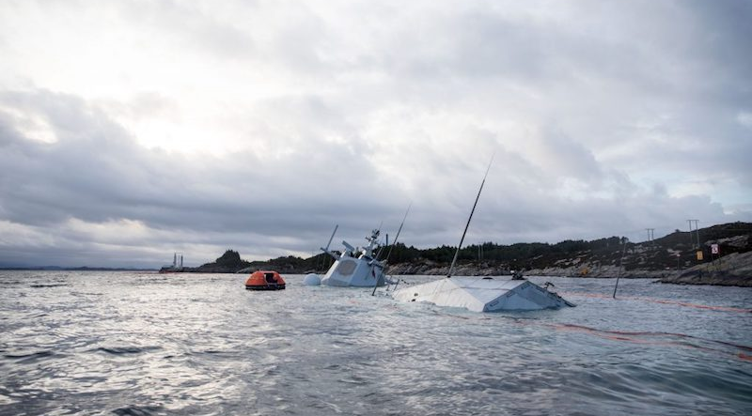
Time for e-Navigation to deliver:
Research has produced; implementation is lagging, in the meantime accidents happen.
Thomas Porathe
Professor, Interaction Design
Department of Design
Norwegian University of Science and Technology
Trondheim, Norway

Slide 2
Research has produced; implementation is lagging

Slide 3
”10 yrs for IMO to make a decision”

Slide 4


”10 yrs for IMO to make a decision”
2009 - 2011

Slide 5
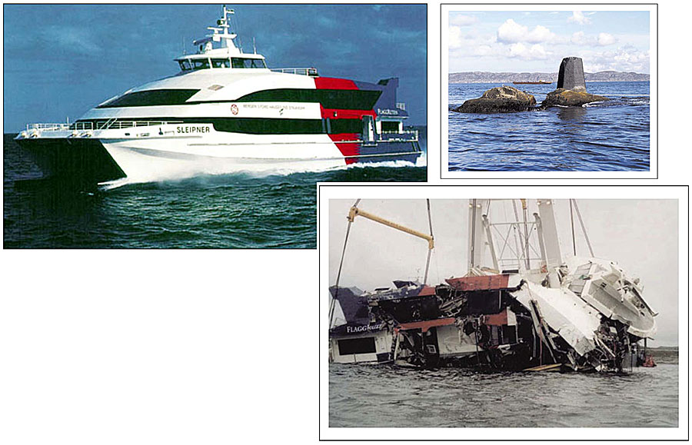
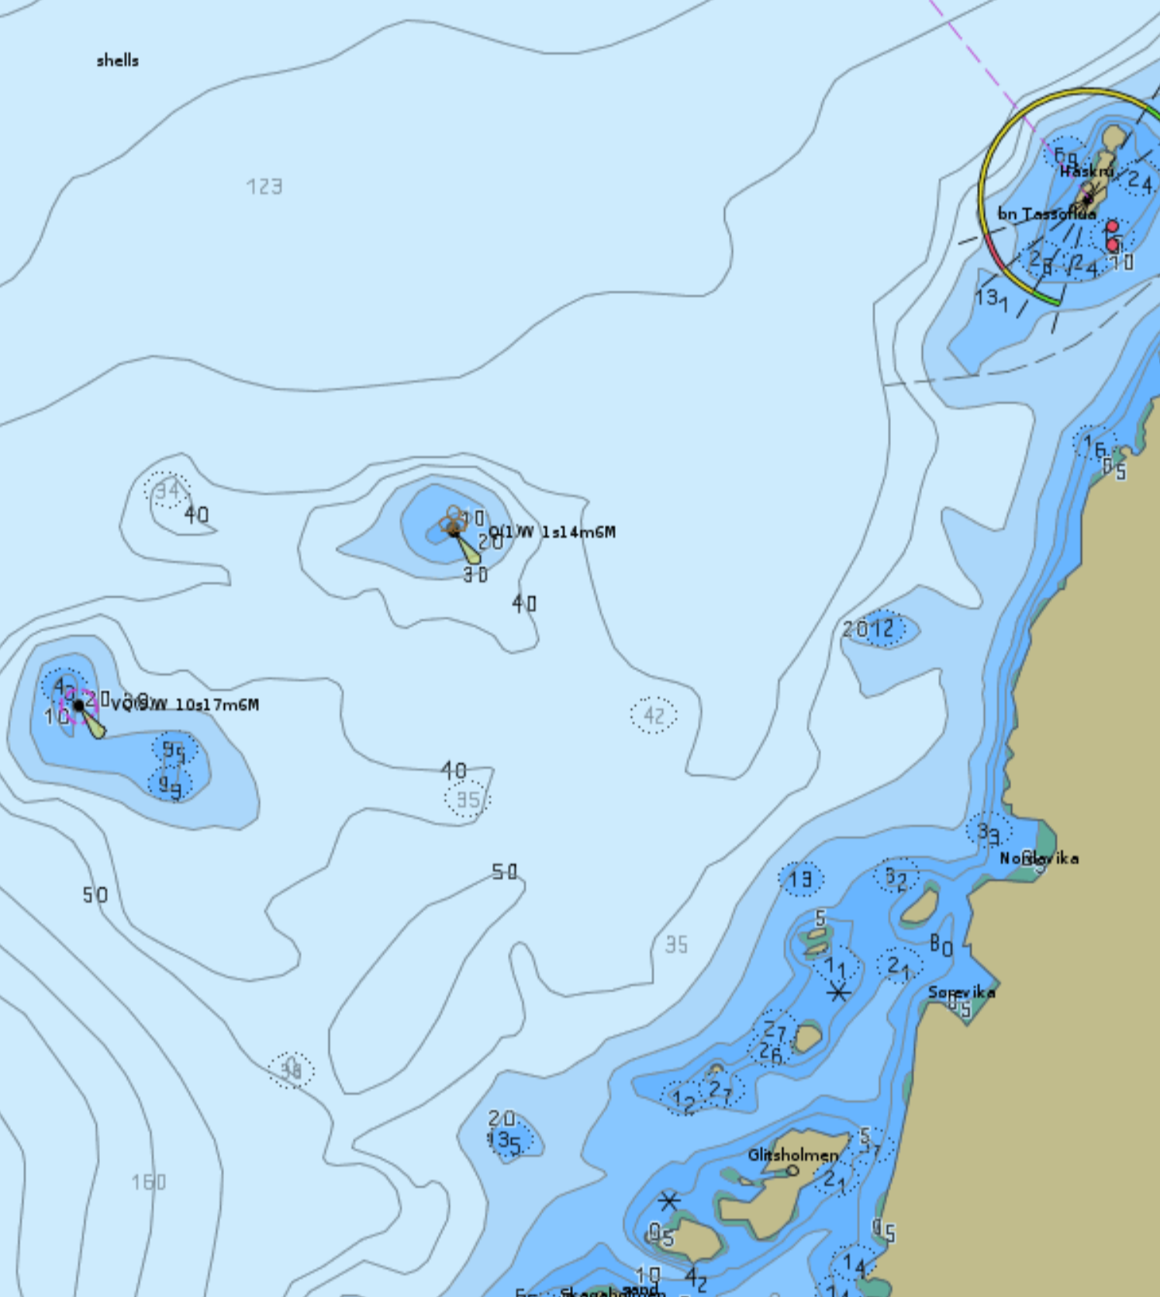
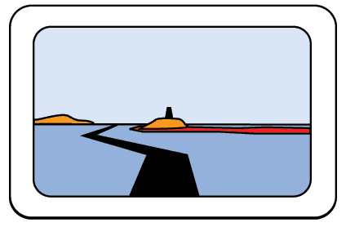
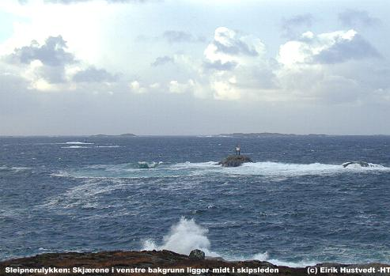
The Sleipner accident 1999
Notes:
The point was to present crucial information in a way that highly stressed people could absorb in a Scrambled situation and make the right decision with their gut feeling. Presented the egocentric chart view (“3D-charts”) to the amused 2nd IHO-HSSC Meeting in Rostock in 2010. The standard did not facilitate taking a 3D view on chart data. But since we have the S102. That is nice.

Slide 6
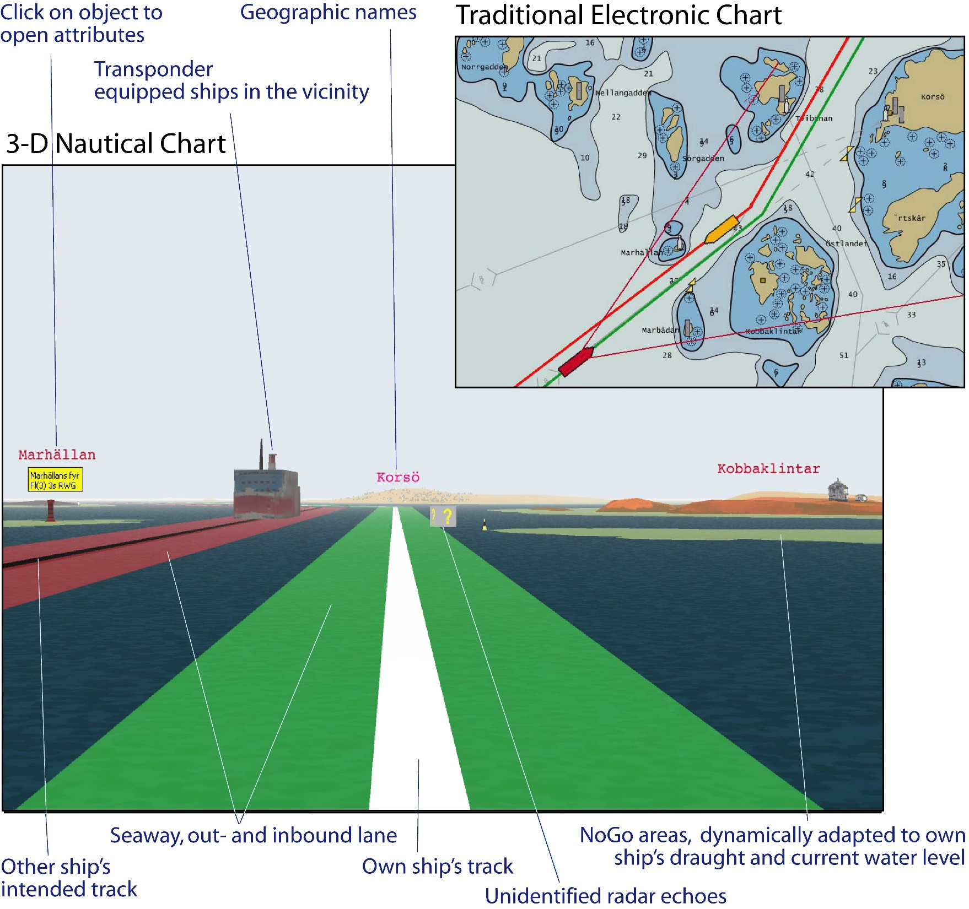
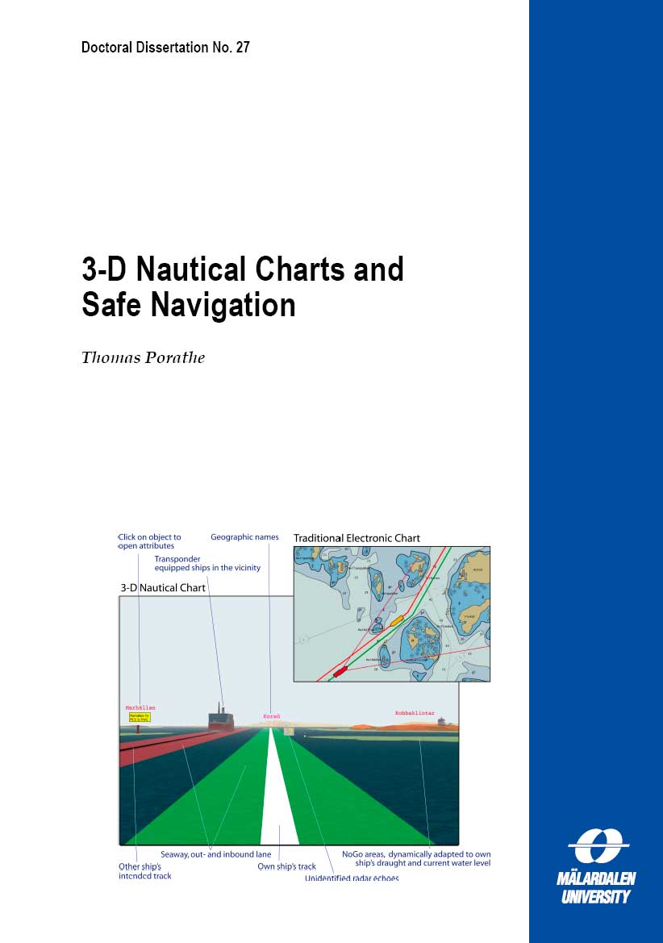
2006

Slide 7
Research goals
Support the OOW at different levels of stress
”Strategic”
”Tactical”
”Opportunistic”
”Scrambled”
Reduce information overload
Cognitive off-loading
Workload management

Slide 8

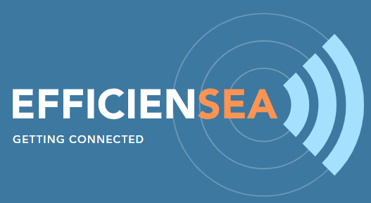




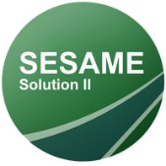
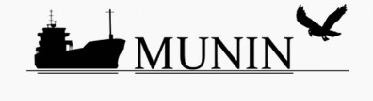

Research
BLAST 2009-’11
EfficienSea 1 + 2, 2009-’11, 2015-’18
MONALISA 1+ 2, 2010-’13, 2012-’15
MICE, 2011-’13
ACCSEAS, 2012-’15
MUNIN, 2012-’15
SESAME 1+2, 2015-’17, 2018-’20
STM validation, 2016-’18

Slide 9
Route coordination
Intended routes
Suggested routes
Moving haven
No-go areas
MSI
Automatic ship reporting
etc.

Slide 10
In the meantime accidents happen

Slide 11
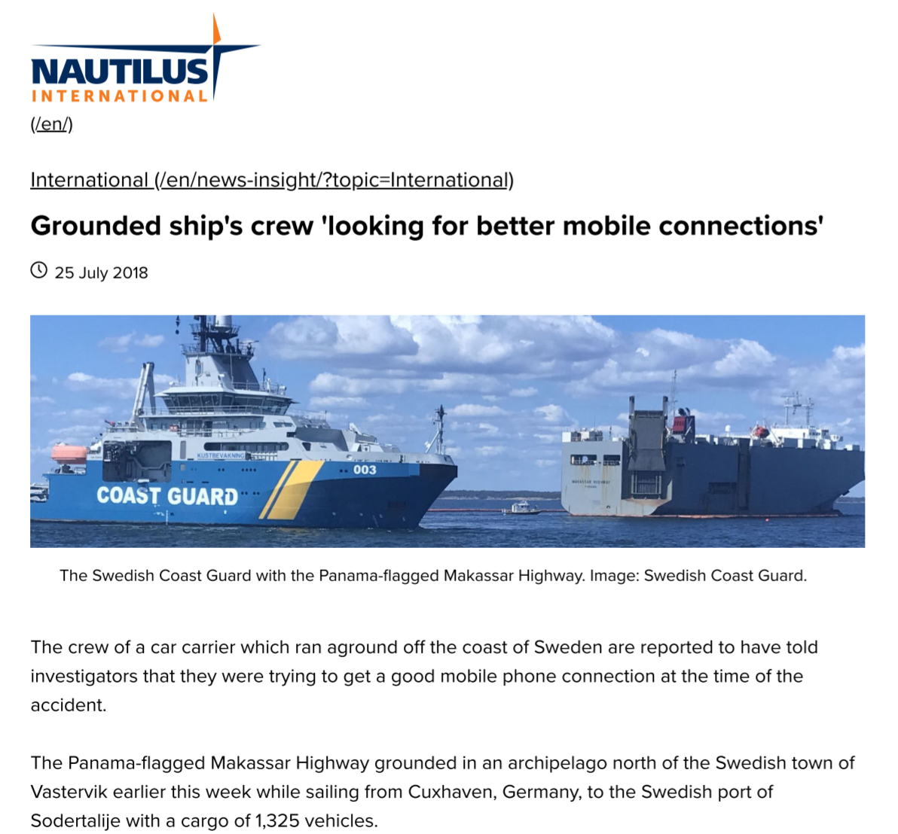

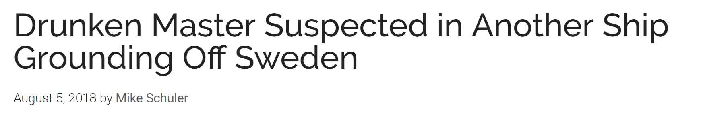
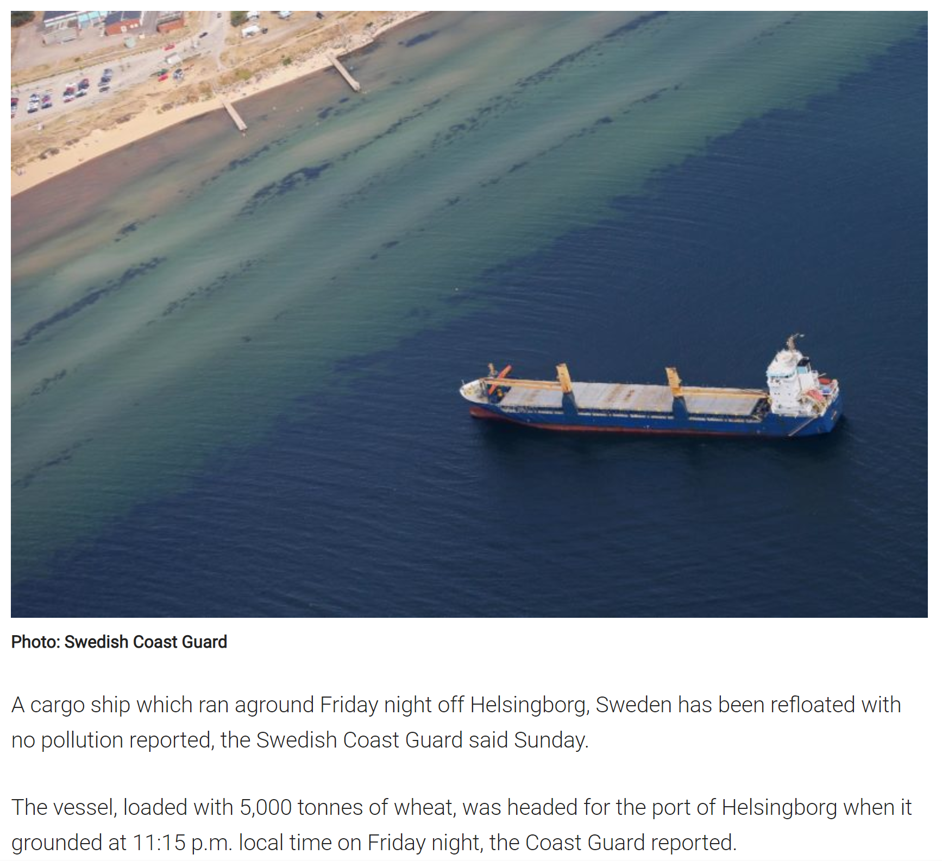

Slide 12
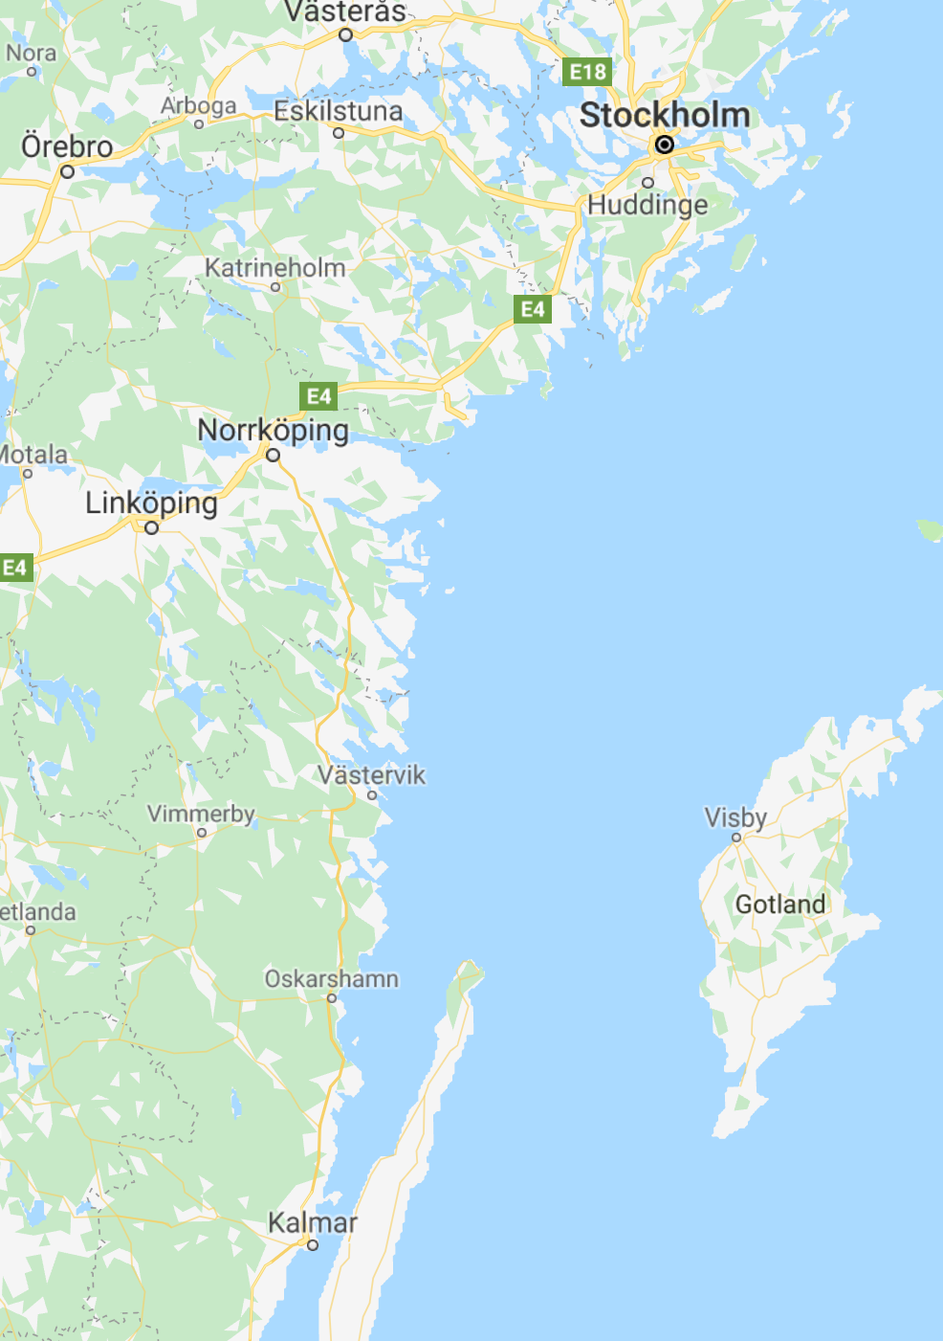
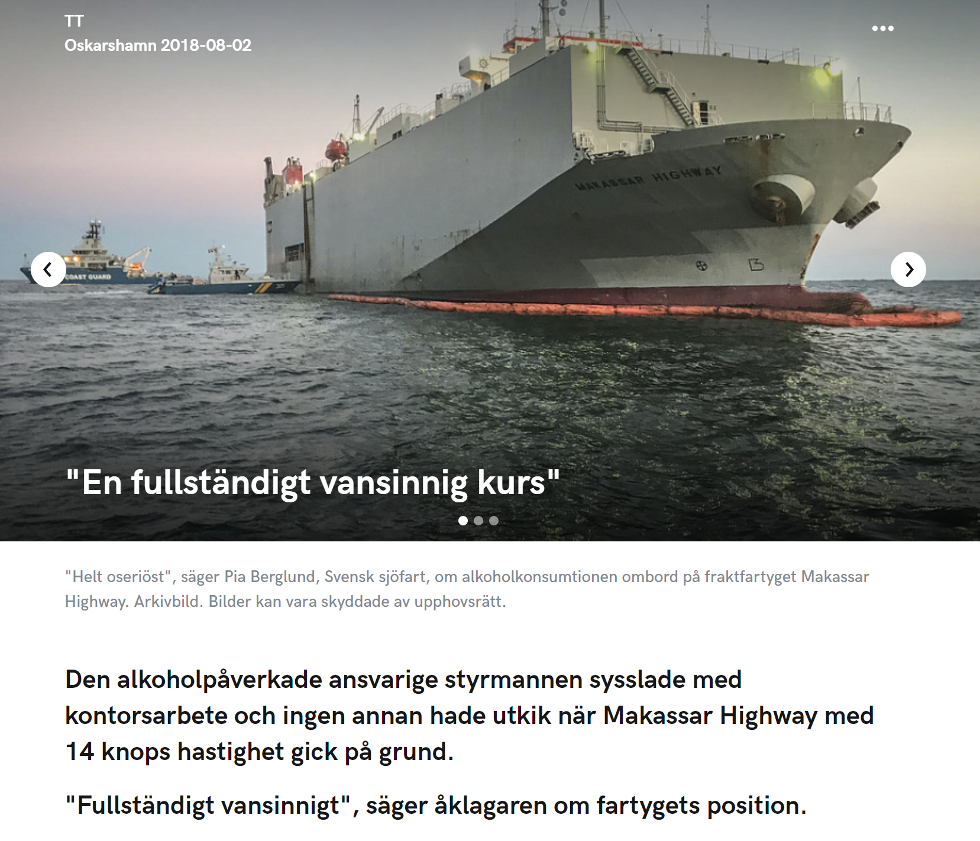
Makassar Highway 23 July 2018
https://www.njus.me/se/nyheter/blaljus/0/720114/en-fullstandigt-vansinnig-kurs

Slide 13
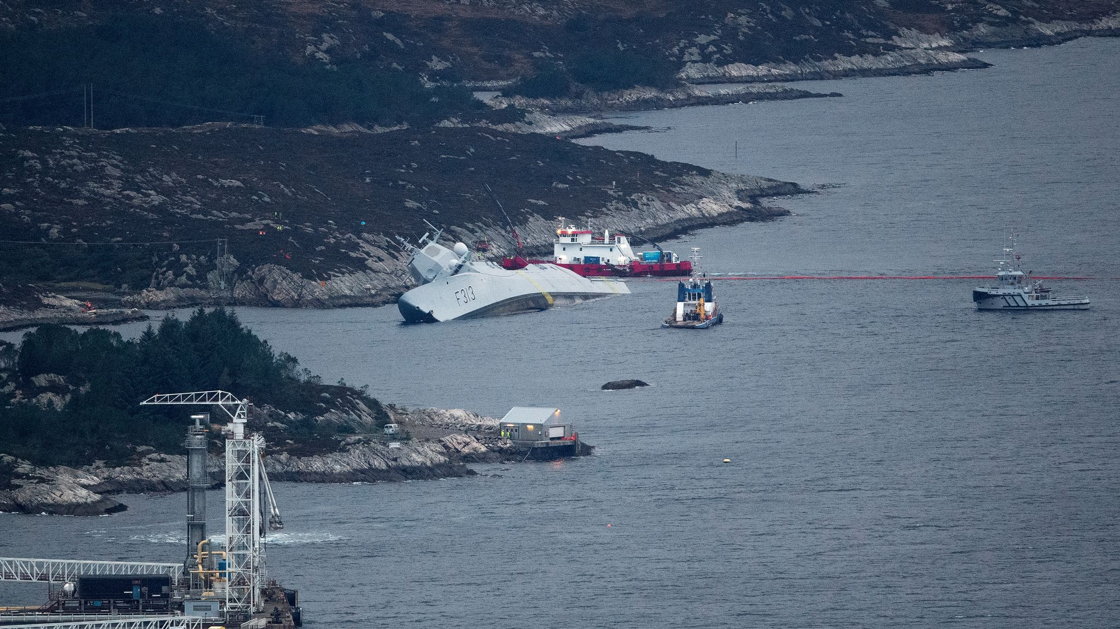
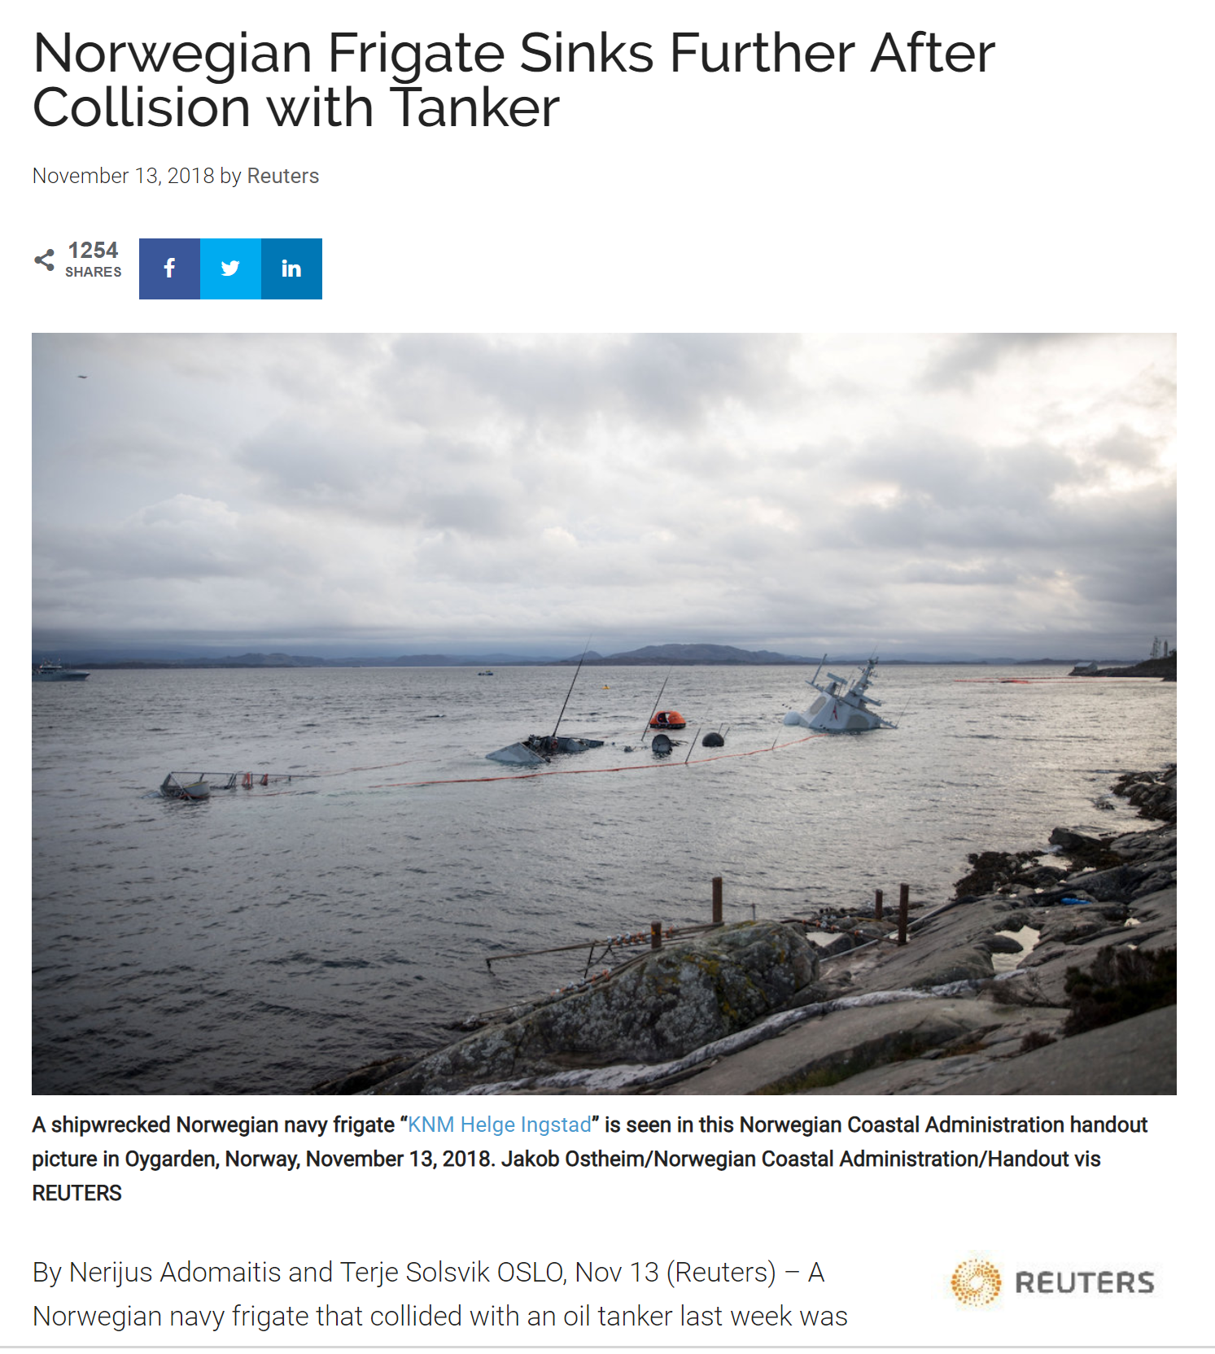

Slide 14
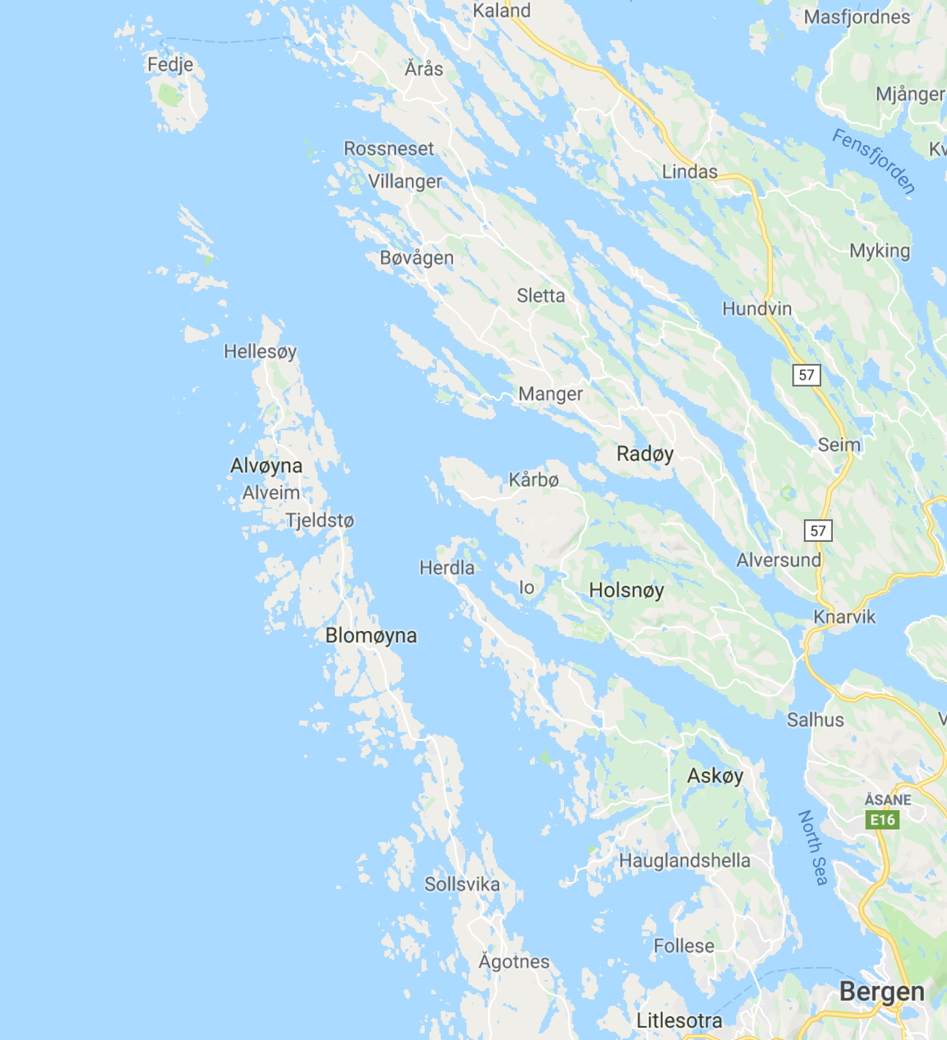
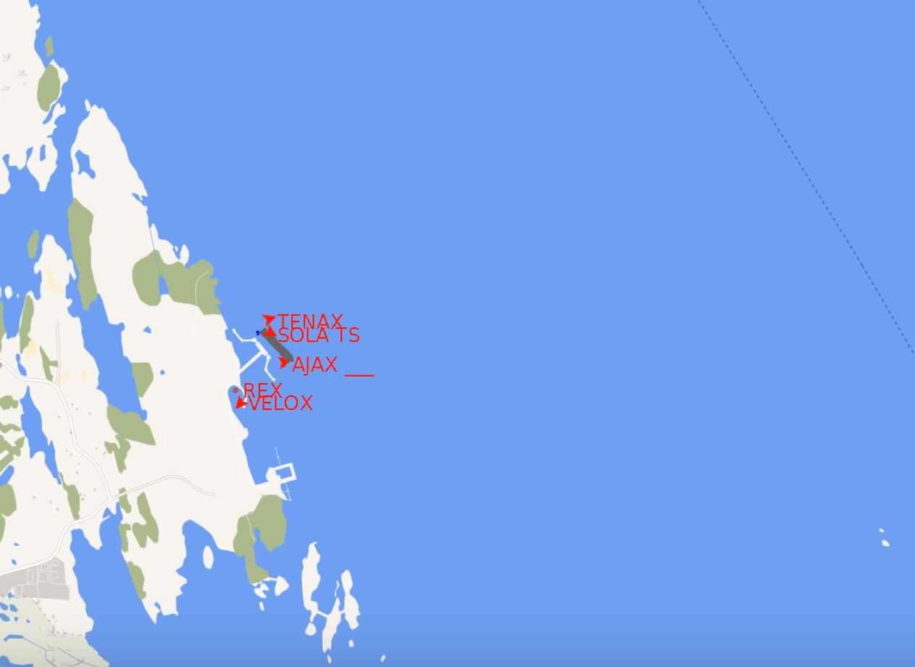
Sola TS leaves quay aprox 3:45

Slide 15
Da terminalen først ble synlig for KNM Helge Ingstad, lå Sola TS til kai ved terminalen. Fordi besetningen på tankskipet forberedte avgang, var dekket på Sola TS betydelig opplyst. På avstand vil det ha vært vanskelig å skille mellom lysene fra skipet og lysene fra terminalen. Det var heller ingen bevegelse i lysene ettersom tankskipet fortsatt lå til kai. Begge disse faktorene har etter all sannsynlighet bidratt til at besetningen på KNM Helge Ingstad tidlig fikk inntrykk av at lysene tilhørte et stasjonært objekt.
Translated from the preliminary report published by the Norwegian accident commision 29 Nov. 2018
When the terminal was first visible to KNM Helge Ingstad, Sola TS lay at the quay at the terminal. Because the crew of the tanker prepared for departure, the deck of the Sola TS was significantly illuminated. At a distance, it would have been difficult to distinguish between the lights of the ship and the lights of the terminal. There was also no movement in the lights as the tanker was still at the quay. Both of these factors have in all likelihood contributed to the fact that the crew of KNM Helge Ingstad early got the impression that the lights belonged to a stationary object.

Slide 16
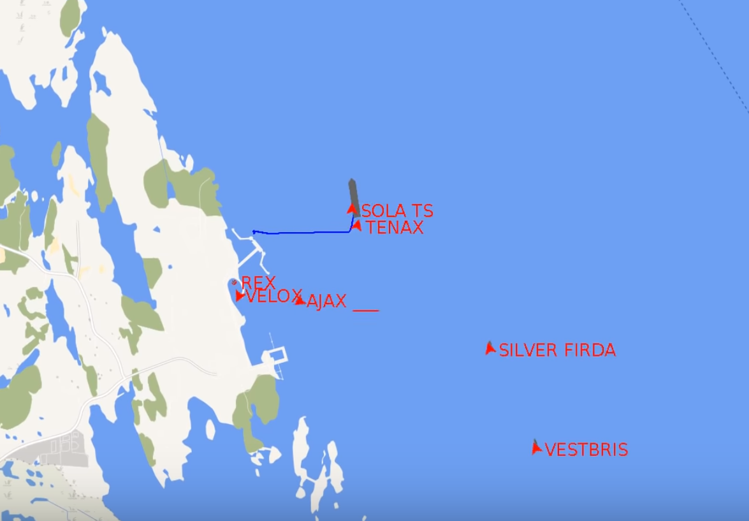
Sola TS has turned to course aprox 3:55
3 other northbound vessels are about to pass on her starboard side

Slide 17
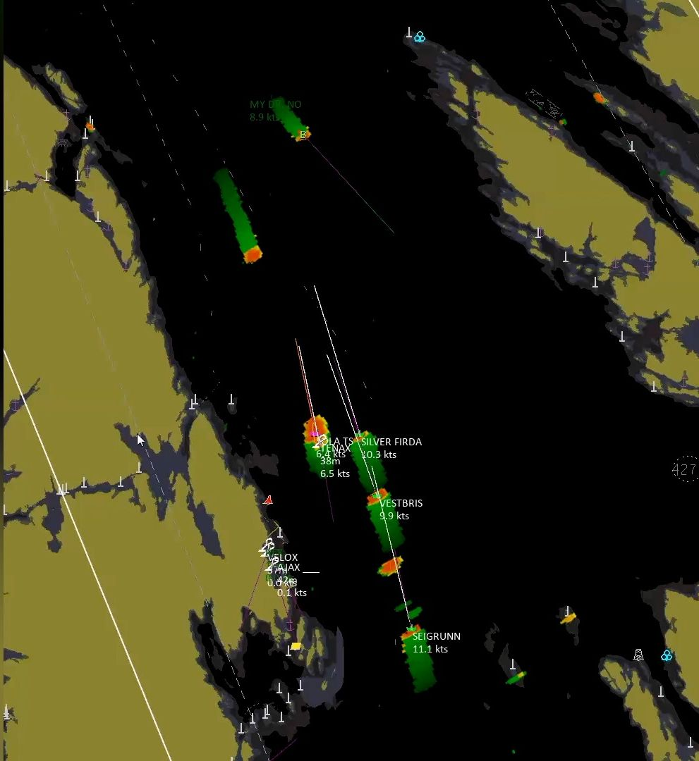

Slide 18
Translated from the preliminary report published by the Norwegian accident commision 29 Nov. 2018
After the watch was shifted on the bridge approx. 0340-0345 it was this situational awareness that was the common understanding. Although Sola TS left the quay at this time, there was still little relative movement on the lights while the tanker swung from a southerly to a northerly course. The vessel's use of deck lights after departure also meant that the crew of KNM Helge Ingstad did not see the navigation lights on Sola TS.

Slide 19
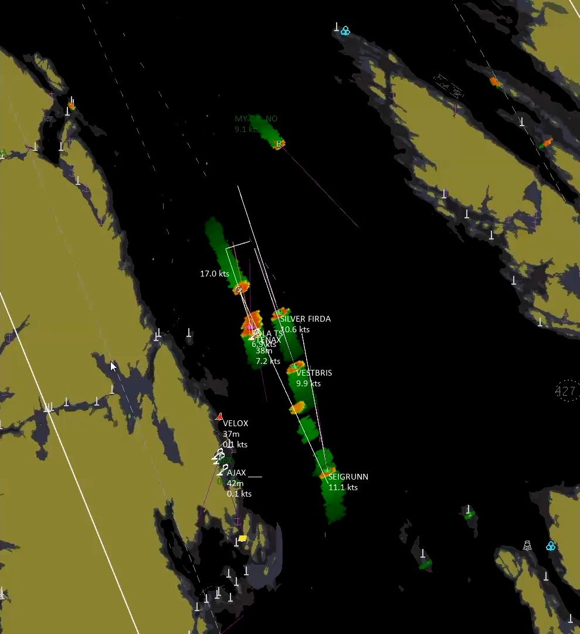

Slide 20
Translated from the preliminary report published by the Norwegian accident commision 29 Nov. 2018
Shortly after 0400, the pilot on Sola TS called KNM Helge Ingstad and told that they had to turn starboard immediately. The bridge crew at KNM Helge Ingstad responded that they could not turn to starboard until they had passed the object they had on their starboard side.

Slide 21


Slide 22
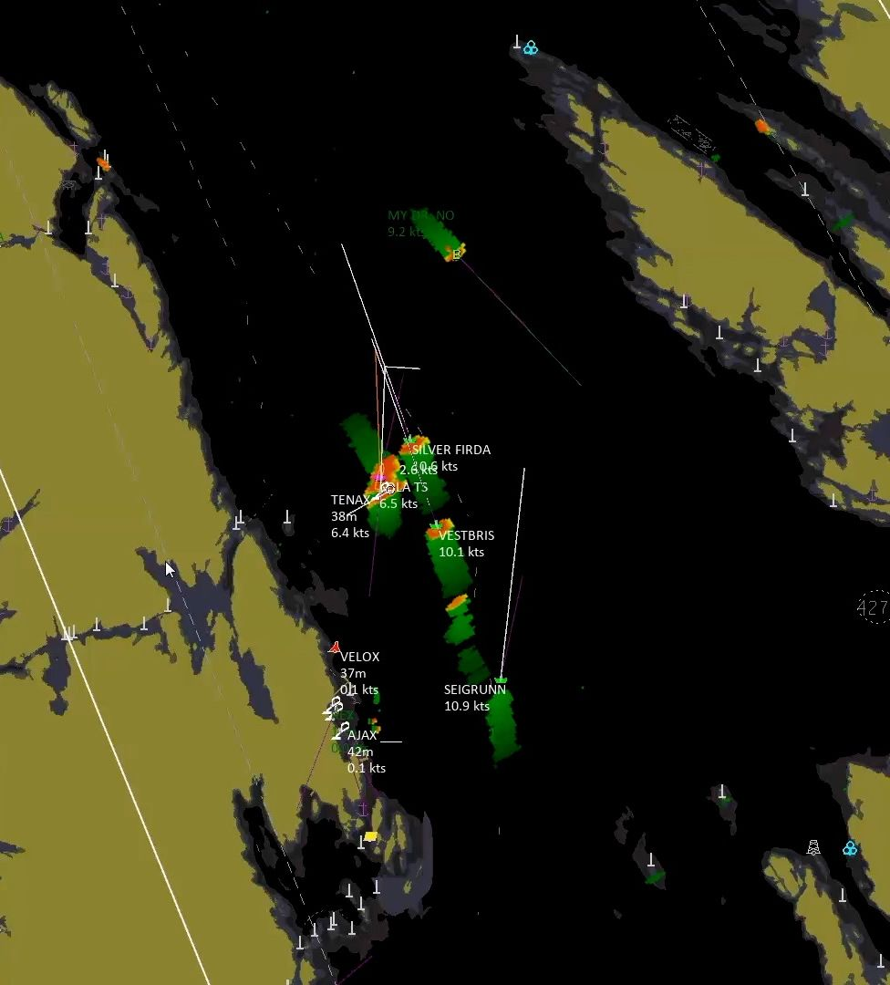

Slide 23
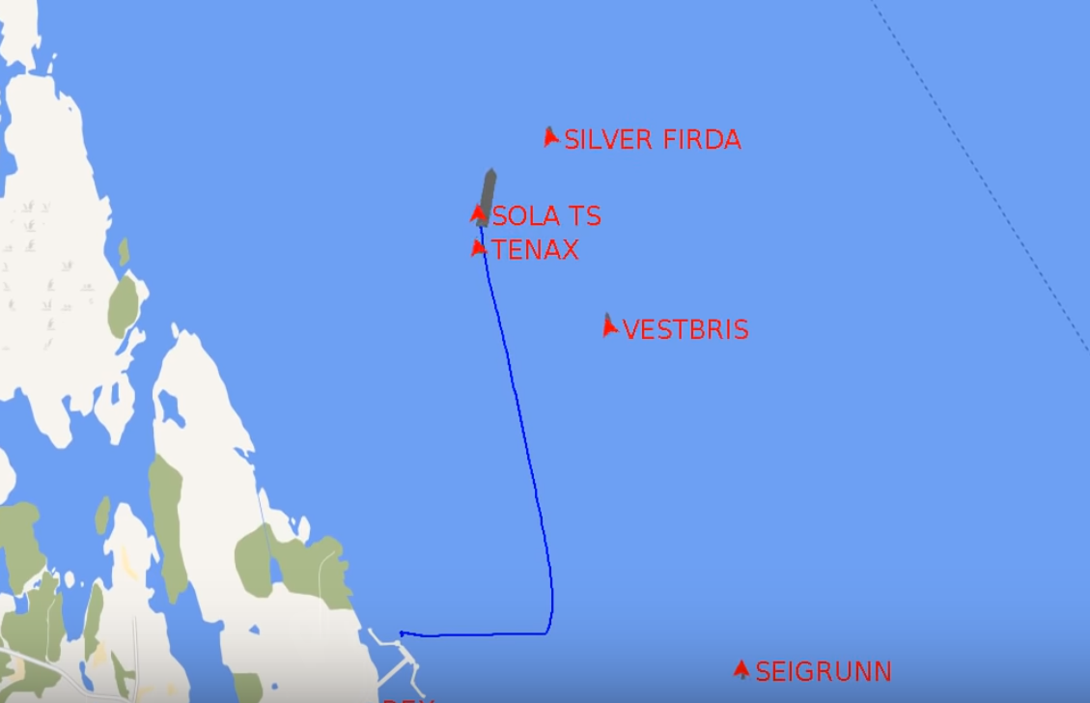
Sola TS collides with the frigate aprox 4:01 (Frigate has her AIS turned off)

Slide 24
Cognitive inerthia/lock-in
Confirmation bias
4 o’clock in the morning
”Head-down” vs ”head-up” (Tactical vs Scrambled information displays)

Slide 25
Cognitive inerthia/lock-in
Confirmation bias
4 o’clock in the morning
”Head-down” vs ”head-up” (Tactical vs Scrambled information displays)
Hypotehsis is that some of the things we have researched could potentially mitigate accidents like these.

Slide 26
Route coordination
Intended routes
Suggested routes
Moving haven
No-go areas
MSI
Automatic ship reporting
etc.

Slide 27
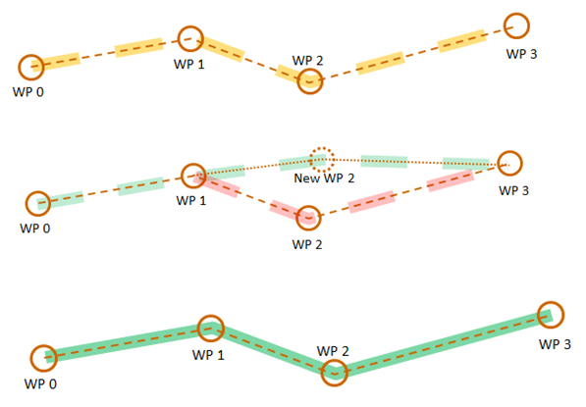
Route exchange
Flow
Visual
Service providers
Ship
STCC
Ship plans route…
… or requests route from service provider
Ship sends route suggestion to STCC.
Ship rejects amended route and suggests new route…
STCC checks route and recommends or suggests amendments…
Ship agrees recommended/ amended route
Porathe, T., de Vries, L., & Prison, P. (2014). Ship voyage plan coordination in the MONALISA project: user tests of a prototype ship traffic management system In D. De Waard, K. Brookhuis, R. Wiczorek, F. Di Nocera, P. Barham, C. Weikert, A. Kluge, W. Gerbino, and A. Toffetti, (Eds.) Proceedings of the Human Factors and Ergonomics Society Europe Chapter 2013 Annual Conference.

Slide 28
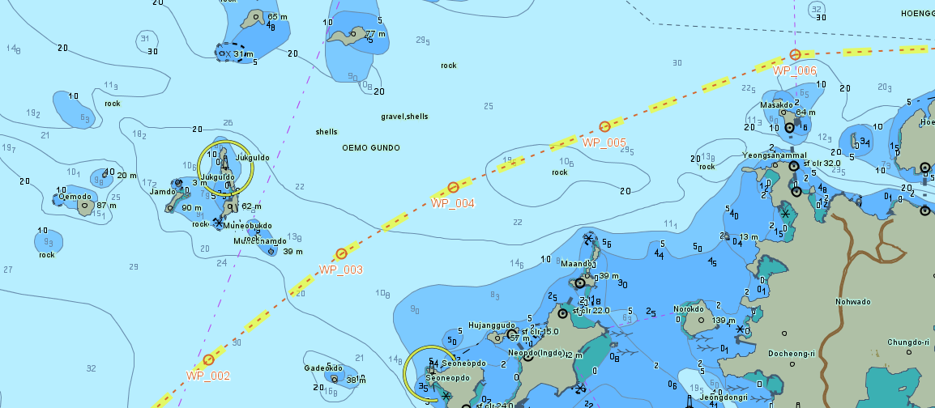
Route exchange
Brödje, A.; Weber, R; Camre, D.; Borup, O.; & Porathe, T. (2015). Supporting Voice Communication Between Navigator and VTS by Visual Solutions-Exploring the Use of the" Route Suggestion" Functionality within VTS. In Information, Communication and Environment: Marine Navigation and Safety of Sea Transportation. CRC Press, 267-274
Porathe, T., Brodje, A., Weber, R., Camre, D., & Borup, O. (2015). Supporting Situation Awareness on the bridge: testing route exchange in a practical e-Navigation study. In A. Weintrit, & T. Neumann (Eds.) Information, Communication and Environment: Marine Navigation and Safety of Sea Transportation, London: CRC Press, 85-92.
Notes:
Route exchange was tested in the MONALISA project with cadets and ship officers in Korea in 2014 onboard the training ships Hambada and Sae Nuri. The response was very positive.

Slide 29
Route intentions
B
A
Notes:
A solution to this has been developed and tested in a number of e-Navigation projects like the EfficienSea, MONALISA, ACCSEAS, SESAME and the STM project. It is called route exchange. By sharing each others routes ships can show their intentions. A vessel B is approaching own ship A from starboard. Vessel A is the give way ship and will soon need to turn.

Slide 30
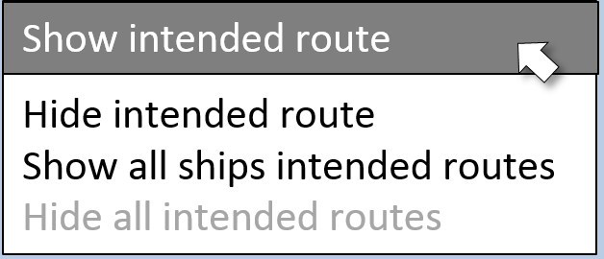
Route intentions
B
A
Notes:
By right-clicking on B’s vessel symbol and choose “Show intended route”…

Slide 31
Route intentions
B
A
Notes:
The intention of vessel B to turn and follow along the fairway is visible. No need for own ship A to turn and give way. For the interaction between autonomous ships and manned ships, and indeed between any type of ships, this service might be of use.

Slide 32
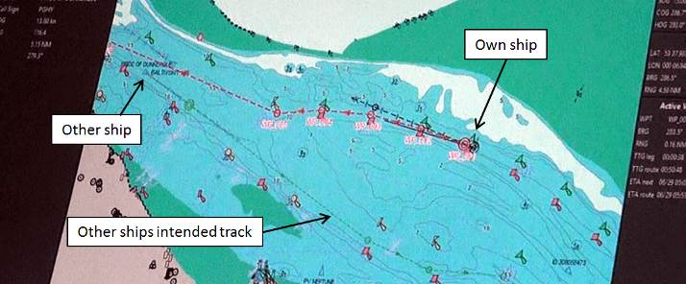
Route intentions
Porathe, T. (2015). Transmitting intended and suggested routes in ship operations: cognitive off-loading by placing knowledge in the world. Work, 41 ( Supplement: 1 ) pp. 4873-4878.
Notes:
Route intentions was also tested in the ACCSEAS project in a simulator simulating the UK Humber estuary with Humber pilots and VTS operators and ship officers trafficking the area. In the screen shot own ship is inbound in the Northern channel and has just queried the outbound “Other ship”. Its intended route is shown passing out through the southern channel.

Slide 33
HMI prototype of “Moving Haven”
(ENAV15, 2014)
COG 175.4°
SOG 18.4 kn
Lat 59 ° 15.794 N
Long 17 ° 13.859 E
Wind 124° 6.2 m/s
ROT
Route: Skag - Muga
Target SOG: 18.5 kn
Course: 175°
Dist. 23.4 NM
0.5
° /min
Target speed
13.4 kn
(13.2 kn)
WP14, ETA 12.58
WP14, ETA 13.25
Maritime Messaging Service
STCC monitoring service
Turn Sb 1 hr. 12 min. to 178 deg. Meet Tarnland on port, side in 23 min.
Send

Slide 34
”Moving haven” VTS view
Moving havens
- 1 hr
Now
+ 1 hr

Slide 35
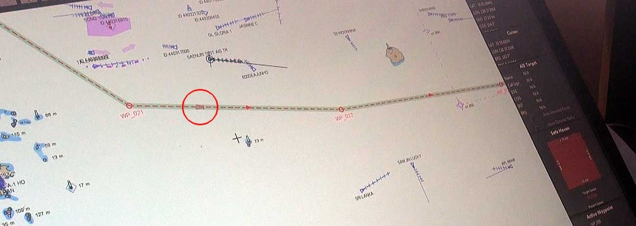
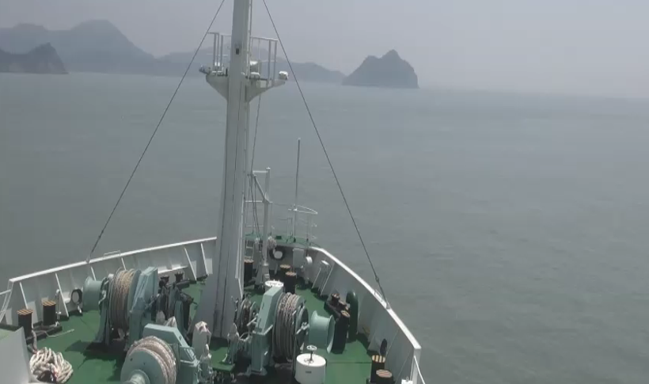
Moving havens
Ship
Moving haven
Conning window
Moving haven in ECDIS during a technical tests Korea 2013
(For safety reasons the ship was not allowed to navigate using the Safe haven)

Slide 36
Implementation is lagging
”10 yrs for IMO implementation”
The future offers no suspension

Slide 37
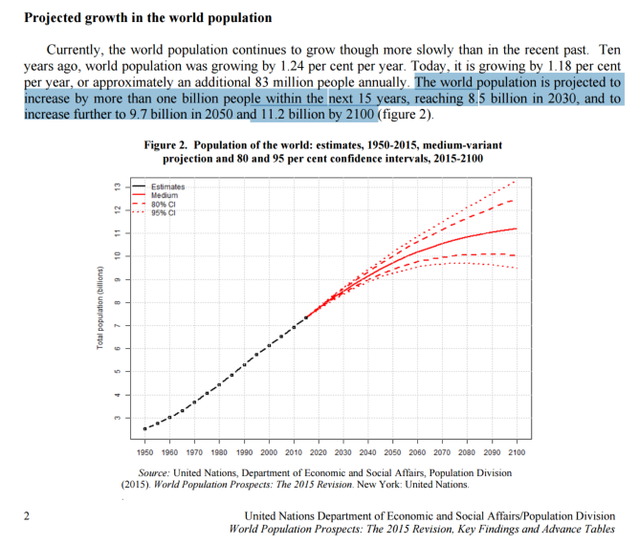
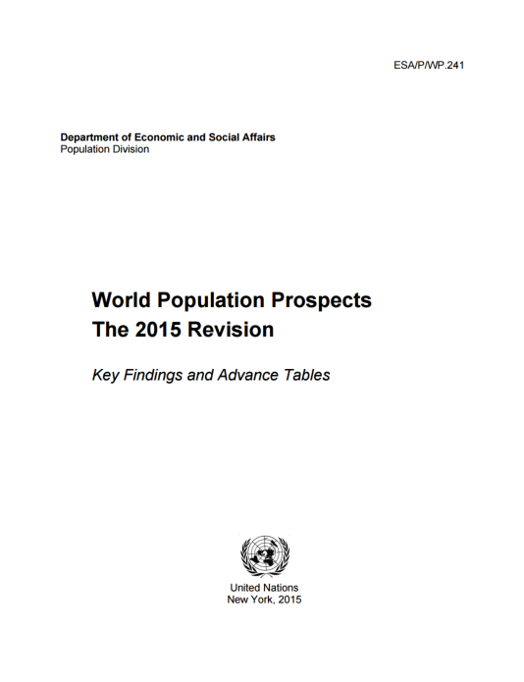

Slide 38
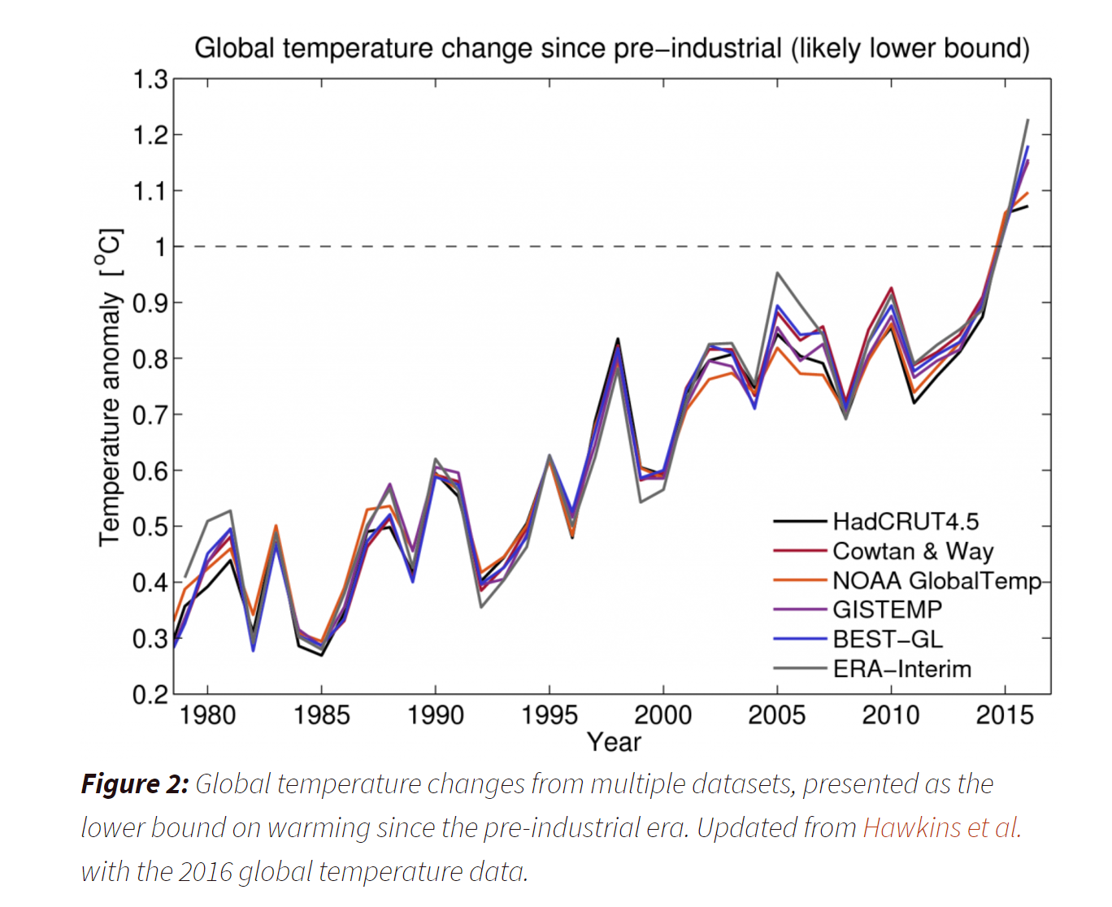
Warming climate is likely to raise this year’s temperature to 1° Celsius above the pre-industrial era,
The UN Paris Agreement on climate change aims to ensure increases in global temperature are less than 2°C above ‘pre-industrial’ levels, with an aspirational 1.5°C limit.

Slide 39
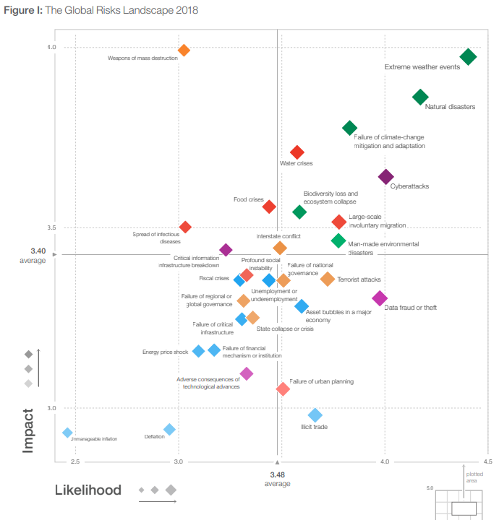
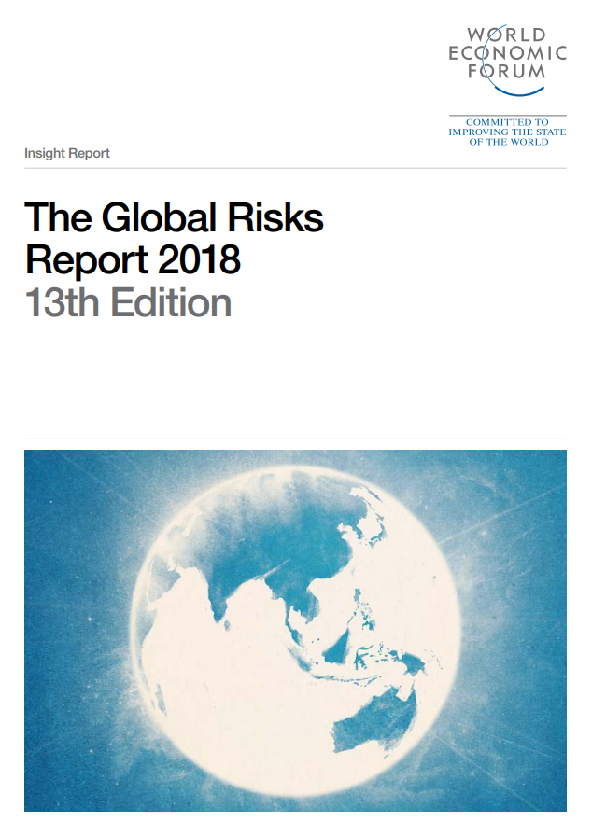
2018

Slide 40
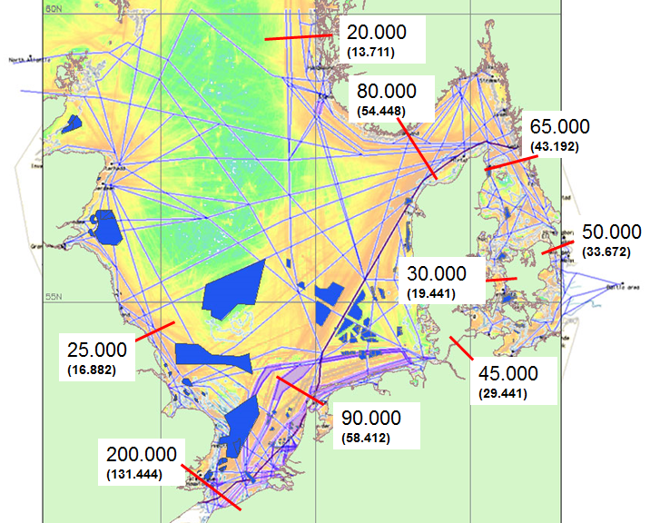
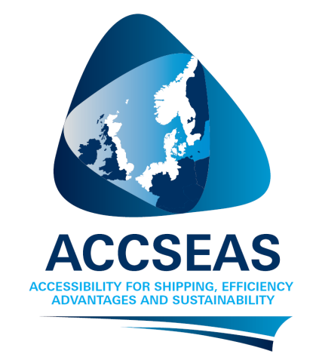
North Sea Region
estimated traffic
2025 (2012)

Slide 41
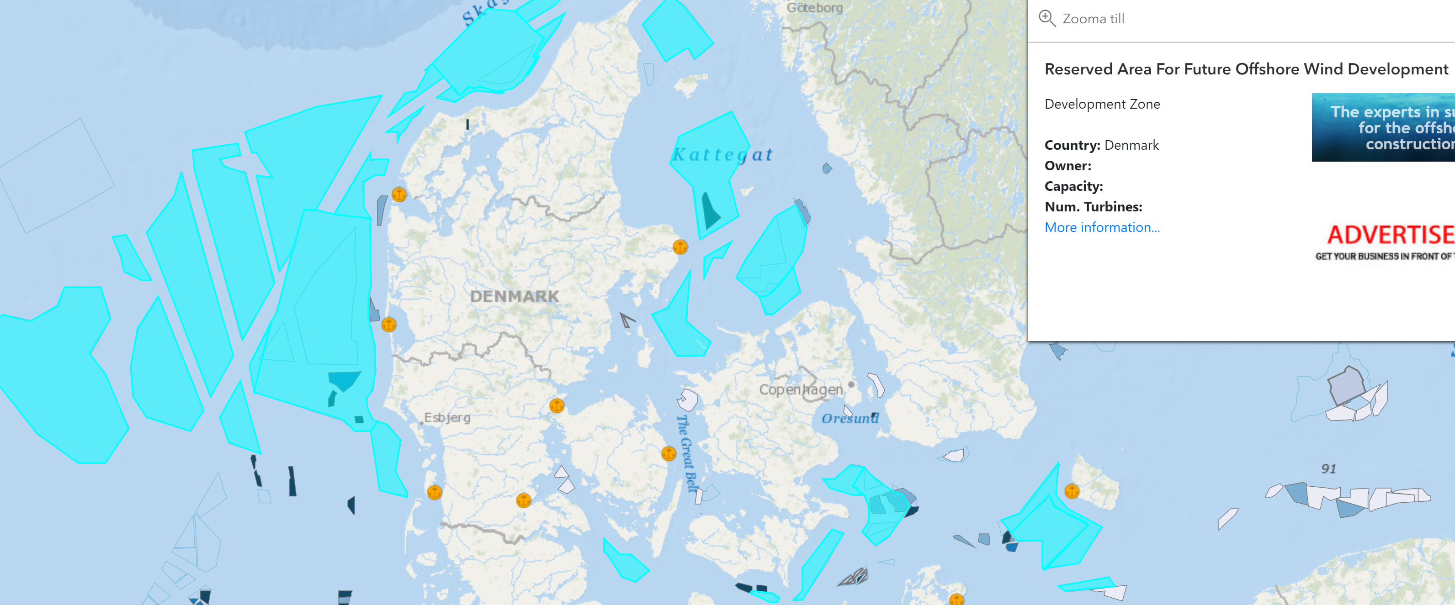
https://www.4coffshore.com

Slide 42
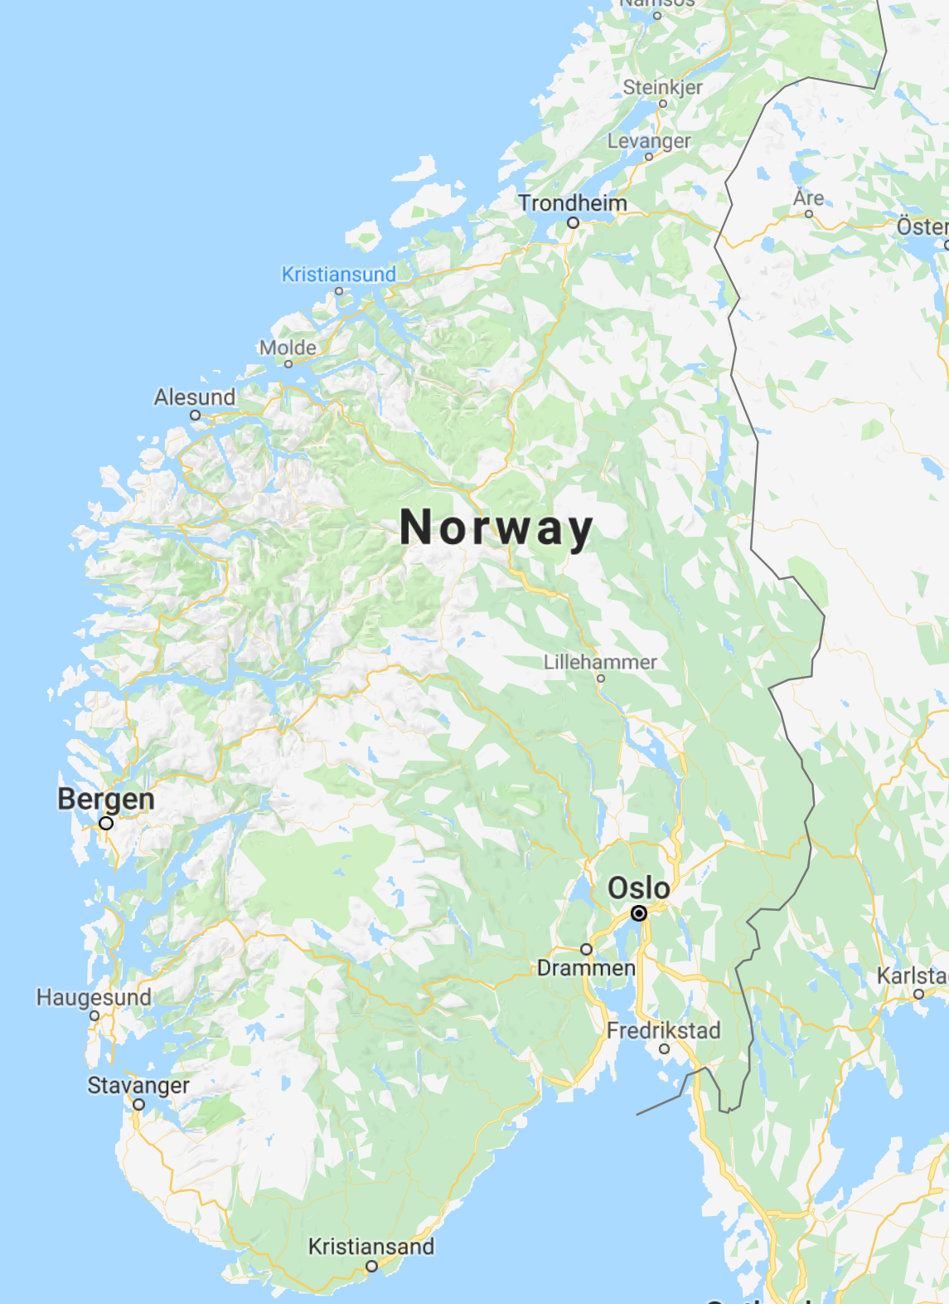
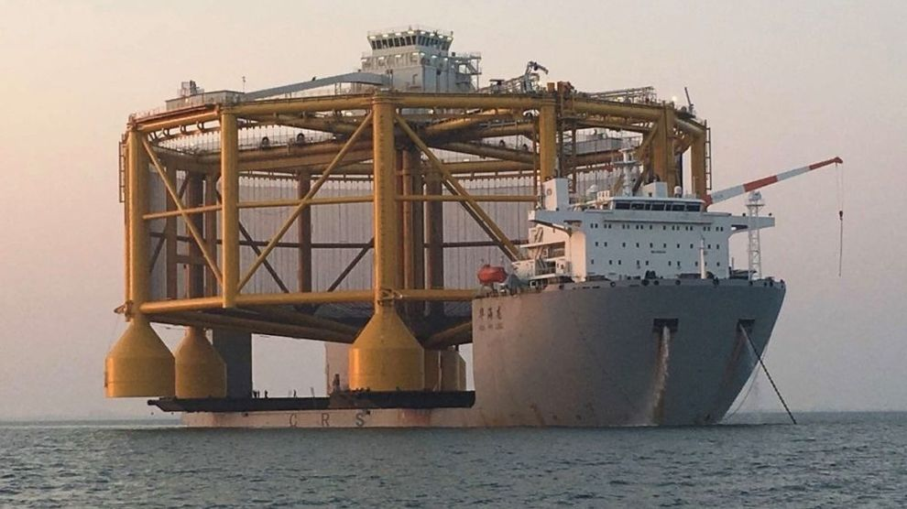
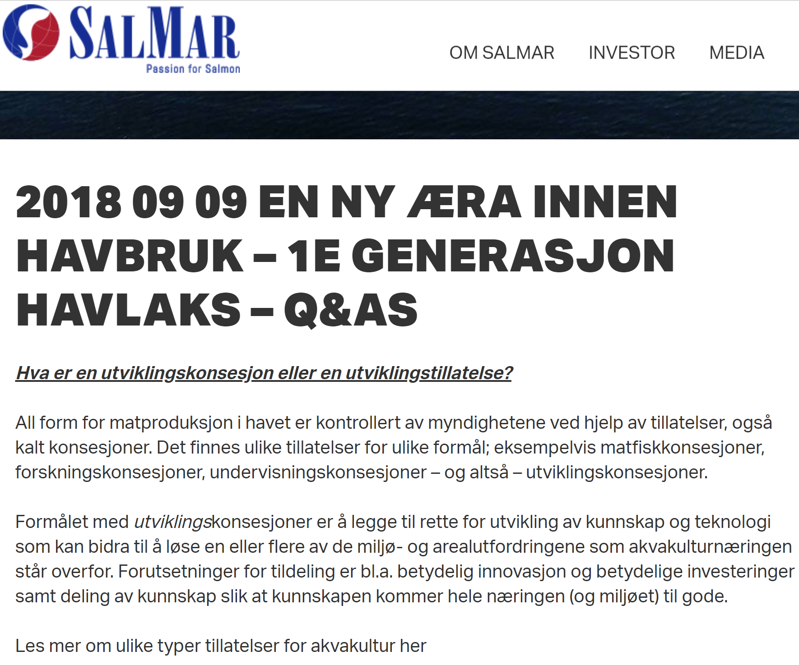
9 September 2018. A new aera in ocean farming The 1st generation sea salmon

Slide 43
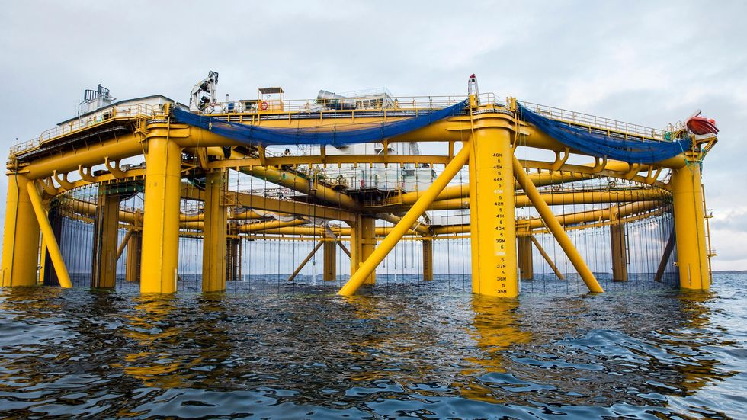

Slide 44
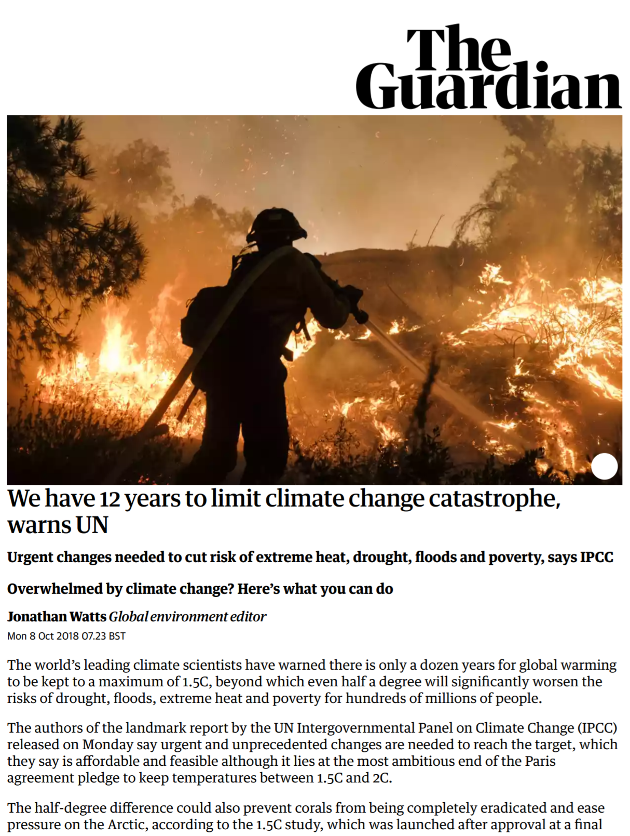
The Guardian 8 Oct. 2018
https://www.theguardian.com/environment/2018/oct/08/global-warming-must-not-exceed-15c-warns-landmark-un-report
Implementation is lagging
The future offers no suspension

Slide 45
The Guardian 8 Oct. 2018
https://www.theguardian.com/environment/2018/oct/08/global-warming-must-not-exceed-15c-warns-landmark-un-report
Implementation is lagging
The future offers no suspension
As climate change redraws the map of where food is produced and water awaliable, populations need to remain in their home counties to prevent political and social disruption.
An increased need for transportation together with an increased competition for ocean space calls for e-Navigation methods

